Slide 1
SIX SIGMA BLACK BELT PROJECT
To Improve Credit Card Resolution Percentage
Project Lead : Dushyant Kumar Verma

Slide 2
DMAIC Process
Define
Define the project goals and customer deliverables
Measure
Measure the process to determine current performance and quantify the problem
Analyze
Analyse and determine the root causes of the defects
Improve
Improve the process by eliminating defects
Control
Control future process performance so that the improved process does not degrade

Slide 3
Voice of Business and Customer
Business/Customer | VOB/VOC | CTQ
Client | The customer resolution percentage has been declining over the months, which is impacting business cash flow. | Lower customer resolution rate.
Operations Head | Declining customer resolution is negatively impacting business, leading to penalties and risking the loss of business. | Reduce penalties, mitigate the risk of losing business

Slide 4

DEFINE

Slide 5
SIPOC
Supplier | Input | Process | Output | Customer
Client/Bank | List of Defaulter Customers | Get the allocation of defaulter customers from the client/bank. | Get the allotment for calling | MIS Team
Analytics Team | Calling Strategy | MIS/Analytics team prepare the calling strategy and allocate to the agents. | Allocations to the agents | Agents
Tech team implemented CRM | Customer's calling details | Agents will call the customers. | Call logs or updated CRM records | Monitoring Team
Tech team implemented CRM | Customers response | Note the disposition of each customer and update CRM. | Paid Status of Customer | Borrower
MIS Team | Customer Status | Inform the client/Get the update of customer status from CRM and update MIS. | Each customer Disposition | Client/Bank
Training Team | Feedbacks based on the customers handling | Training to Team leaders and agents based on Feedback | Improved handling of customers | Team leaders and agents

Slide 6
Project Charter :- To Improve Credit Card Resolution %
Background :- Alpha Finance Company, a financial institution regulated by the Reserve Bank of India, operates across the entire country. The company's primary business involves issuing credit cards to various customer segments.
Business Case :- ABC Ltd, manage the collection process for Alpha Finance based in Thane with an agent headcount of 30. From Jan’24 to June’24, the average collection rate is 32.37%. This means only ₹9.78 crores of the ₹30 crores due are collected, impacting cash flow by ₹20.22 crores. In the last internal meeting, the COO highlighted a declining trend in collections. This needs to be improved in order to retain the business with us. This makes it critical to initiate this project. Without improvement, this will negatively affect business opportunities and cash flow.
Problem Statement:- From January 2024 to June 2024, the collection rate is 32.37%, Which is lower than the requirement of 40%.
Project Scope
In Scope | Location: PAN India FTE:- 30 Volume/Monthly:5000 Channel: Outbound Language: English, Hindi
Out of Scope | NA
Goal Statement:- To improve the Credit card collection from 32.37% to 40% by 30th Dec'24
Business Benefits:-
1. Client Benefit: ₹ 18 Cr additional resolution per year
2. ABC Benefit:- ₹ 2.43 Cr annually (Business retention)
Project Plan
Phase | Start | End | Remarks
Define | 20/06/24 | 27/06/24 | 1 week
Measure | 27/06/24 | 03/07/24 | 1 week
Analyze | 03/07/24 | 24/07/24 | 2-3 weeks
Improve | 24/07/24 | 24/08/24 | 6-8 weeks
Control | 24/08/24 | 24/12/24 | 6-8 weeks
Project Team
Sponser | Mr. Rajesh Kumar
Champion | Dr. Priya Singh
MBB | Mr. Jatin
Project Leader | Dushyant Verma
Team Members | Anjali Verma 2. Vivek Sharma 3. Neha Patel

Slide 7
ARMI (Approver – Resource – Member – Interested Party)
Key Stakeholder | Define | Measure | Analyze | Improve | Control
Project Sponser: Mr. Rajesh Kumar | I | I | I | I | I
Project Champion: Dr. Priya Singh | A | A | A | A | A
Project Leader: Dushyant Verma | M | M | M | M | M
Team Member/Cross Functional Team Operations Team : Anjali Verma Training Team: Vivek Sharma MIS Team: Neha Patel Analytics Team: Rohan Sharma | M | M | M | M | M
MBB: Mr. Jatin | R | R | R | R | R
What Role | A -Approval of team decisions outside their charter/authorities, i.e., sponsor, business leader R -Resource to the team, one whose expertise, skills, “clout” may be needed on an ad-hoc basis M -Member of team, with the authorities and boundaries of the charter I -Interested party, one who will need to be kept informed on direction, findings

Slide 8
MEASURE

Slide 9
Process Capability
No. of Units (Total Allocations) | No. of Defects (Unpaid Customer) | Defects Opportunities Per Unit | Defect Per Unit (DPU) | Defect Per Opportunity (DPO) | Defect Per Million Opportunity (DPMO) | Sigma Level
30000 | 20289 | 1 | 0.67 | 1 | 676300 | 2.65
Process Sigma = Normsinv(1+D/O)+1.5))
D – Total Defects
O- Total Opportunities
* Total allocations is calculated based on the data from Jan’24 to June’24 taking monthly allocation volume 5000.

Slide 10
Analyze

Slide 11
Brainstorming Session : Potential Causes
Problem Statement: To improve the Credit card collection from 32.37% to 40% by 30th Dec'24
Causes | Attributes as per Fish Bone | Priority/Impact of Causes | Incontrol/Outside control | Process/Data Door
1. Data discrepancies in customer lists. | Method | High | Incontrol | Process Door
2. Delays in updating customer status in the MIS. | Man | High | Incontrol | Process Door
3. Incomplete data fields in the CRM. | Machine | Low | Outside Control | Process Door
4. Inconsistent performance tracking. | Man | High | Incontrol | Process Door
5. Failure to adapt to changes in customer behavior. | Measurement | High | Incontrol | Process Door
6. System downtimes affecting data entry. | Machine | Medium | Outside Control | Process Door
7. CRM integration issues with other tools. | Machine | Medium | Outside Control | Process Door
8. Issue in feeding data in dialler | Machine | High | Outside Control | Process Door
9. Lack of CRM training for users. | Method | Medium | Incontrol | Data Door
10. Delays in CRM updates and patches. | Machine | Medium | Outside Control | Process Door
11. Inadequate training for team leaders and agents. | Method | High | Incontol | Data Door
12. Outdated training materials. | Method | Low | Incontrol | Process Door
13. Lack of follow-up on training effectiveness. | Method | Low | Incontol | Process Door
14. Insufficient focus on handling difficult customers. | Man | High | Incontrol | Data Door
15. Failure to address gaps identified in feedback sessions. | Man | Medium | Incontrol | Process Door
16.Poor coordination between teams. | Method | Medium | Incontol | Process Door
17. Lack of accountability for performance metrics. | Man | Medium | Incontrol | Process Door
18. Misalignment of objectives across teams. | Method | Medium | Incontrol | Process Door
19. Inadequate communication channels. | Method | Low | Incontrol | Process Door
20. Non-availability of analytical solution to build dialling strategy | Method | High | Incontrol | Data Door
21. Non-availability of analytical solution to build refrral strategy | Method | High | Incontol | Data Door
22. BQM process is not carried out effectively | Man | High | Incontrol | Data Door
23. POS Band categorization is not proper | Measurement | Medium | Incontrol | Data Door
24. New agent is performing relatively low | Man | High | Incontrol | Data Door
25. FCR Performance is not available | Method | Low | Incontrol | Data Door
26. Public Holidays cause drop in collection % | Method | Low | Outside Control | Process Door

Slide 12
Control and Impact Matrix
Control | Impact
 | High | Medium
Incontrol | Data discrepancies in customer lists. | Lack of CRM training for users.
 | Delays in updating customer status in the MIS. | Failure to address gaps identified in feedback sessions.
 | Inconsistent performance tracking. | Poor coordination between teams.
 | Failure to adapt to changes in customer behavior. | Lack of accountability for performance metrics.
 | Inadequate training for team leaders and agents. | Misalignment of objectives across teams.
 | Insufficient focus on handling difficult customers. | POS Band categorization is not proper
 | Non-availability of analytical solution to build dialling strategy
 | Non-availability of analytical solution to build refrral strategy
 | BQM process is not carried out effectively
 | New agent is performing relatively low

Slide 13
Fishbone Analysis
Measurement
Method
Data discrepancies in customer lists.
POS Band categorization is not proper
Non-availability of Dialling Strategy
Failure to adapt to changes in customer behavior.
Inadequate training of team leaders
04
03
02
01
EFFECT
Delays in updating customer status in the MIS
IVR or automated system issues
Insufficient focus on handling difficult customers.
New agent is performing relatively low
Machine
BQM process is not carried out effectively
Man

Slide 14
5 Why’s on Process Door Causes
Why | Problem - Data discrepancies in customer lists.
1 | Inaccurate or incomplete data provided by clients.
2 | Lack of clear data submission guidelines for clients and institutions.
3 | Insufficient communication and collaboration between our team and the clients.
4 | Infrequent updates and feedback loops regarding data quality issues.
5 | Absence of a structured process for ongoing engagement and data review with clients.
Root Cause | lack of clear submission guidelines and poor communication.
Corrective Action | Develop and distribute comprehensive data submission guidelines to clients, outlining the required formats and data points.
Preventive Action | Establish regular communication channels (e.g., meetings, feedback sessions) with clients to review data quality, provide updates, and address any discrepancies proactively.

Slide 15
5 Why’s on Process Door Causes
Why | Problem - Delays in updating customer status in the MIS.
1 | The updates are not being entered in a timely manner.
2 | Staff are overwhelmed with other tasks and do not prioritize MIS updates.
3 | There is a lack of resources and staff assigned to manage the MIS updates.
4 | Management has not allocated sufficient staffing or tools to support efficient MIS operations.
5 | There is insufficient assessment of the workload and the importance of timely updates to customer status.
Root Cause | staff being overwhelmed and unable to prioritize MIS updates.
Corrective Action | Reassess staffing needs and allocate additional resources or personnel specifically for managing MIS updates.
Preventive Action | Implement a regular review process to monitor workload and prioritize tasks

Slide 16
5 Why’s on Process Door Causes
Why | Problem - BQM process is not carried out effectively
1 | The BQM process lacks adherence and consistency among the team members.
2 | Team members are unclear about their roles and responsibilities within the BQM process.
3 | Team leaders have not set clear expectations or provided adequate training on the BQM process.
4 | There is a lack of communication and guidelines from management regarding BQM expectations.
5 | Management may not prioritize BQM as a critical component of operational excellence
Root Cause | The ineffective execution of the BQM process is primarily due to unclear expectations and insufficient training provided by team leaders.
Corrective Action | Team leaders should establish clear expectations for agents regarding their roles in the BQM process.
Preventive Action | Develop a structured communication plan from management to ensure ongoing updates, guidelines, and feedback regarding the BQM process.

Slide 17
Waste Identification via TIMWOODS Technique
Waste Type | Identified Cause | Description
Transportation | None identified | Transportation waste refers to unnecessary movement of information, materials, or products.
Inventory | Data discrepancies in customer lists | Inaccurate data can lead to overstocking or incorrect stock levels in the database.
Motion | New agent is performing relatively low | Inefficient movement or actions by agents due to lack of experience and training can lead to delays.
Waiting | Delays in updating customer status in the MIS | Time wasted waiting for updates or information, resulting in inefficient processes.
Overproduction | Non-availability of analytical solution to build dialing/referral strategy | Building more options than needed without proper analysis can lead to wasted resources.
Overprocessing | BQM process is not carried out effectively | Additional steps may be required to process quality management effectively.
Defects | Insufficient focus on handling difficult customers | Failure to address customer issues can lead to dissatisfaction and repeated complaints.
 | Inadequate training for team leaders and agents | Deficiencies in training can lead to errors and defects in customer service.
 | POS Band categorization is not proper | Incorrect categorization may lead to improper handling of customer accounts and dissatisfaction.

Slide 18
Hypothesis Testing Plan
No. | Potential Causes (X) | Data type (X vs Y) | Hypothesis test to be used | Related to Root Cause
1 | Bill cycle of customer | Discrete vs Discrete | Chi square Test | Non-availability of analytical solution to build dialling and referral strategy
2 | Repeat Category | Discrete vs Discrete | Chi square Test
3 | Intensity | Continoues vs Discrete | Binary Logistic Regression
4 | Contactable | Discrete vs Discrete | Chi square Test
5 | PTP Generated | Discrete vs Discrete | Chi square Test
6 | Zone | Discrete vs Discrete | Chi square Test
7 | Tenure | Continoues vs Discrete | Binary Logistic Regression
8 | TL | Discrete vs Discrete | Chi square Test
9 | Training Hours | Continoues vs Continoues | Regression Analysis | Inadequate training for team leaders and agents.
10 | Training Score | Continoues vs Continoues | Regression Analysis
11 | Gross o/s Category | Discrete vs Discrete | Chi square Test | POS Band categorization is not proper
12 | Agent Tenure | Continoues vs Continoues | Regression Analysis | New agent is performing relatively low
13 | Difficult Customer Handled | Continoues vs Continoues | Regression Analysis | Insufficient focus on handling difficult customers.

Slide 19
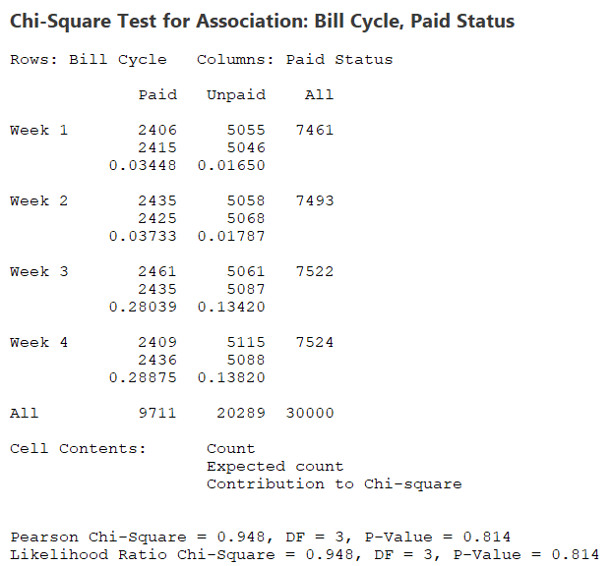
Impact of Credit Card Bill Cycle on Paid Status
Since P value is greater than 0.05, Hence the null hypothesis which means X (Bill Cycle) doesn't have significant impact on Y (Paid Status)

Slide 20
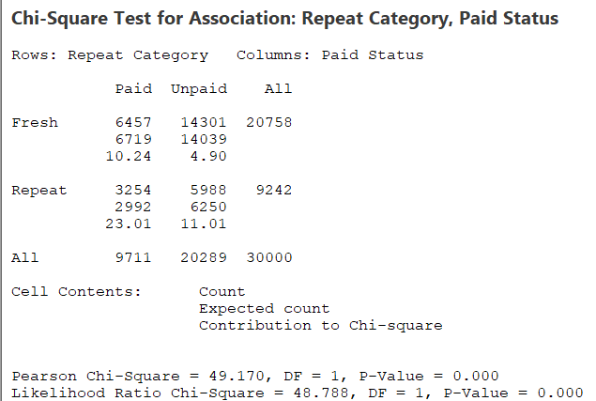
Impact of Repeated Customers over months on Paid Status
Since P Value is very less, less than 0.05, Hence the Alternate Hypothesis which means X (Repeat Category) have significant Impact on Y (Paid Status)
Need an efficient calling strategy to improve the customer resolution for fresh customers.

Slide 21
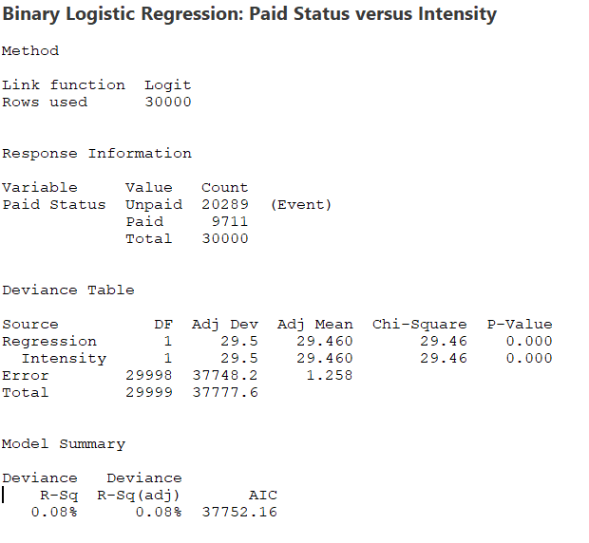
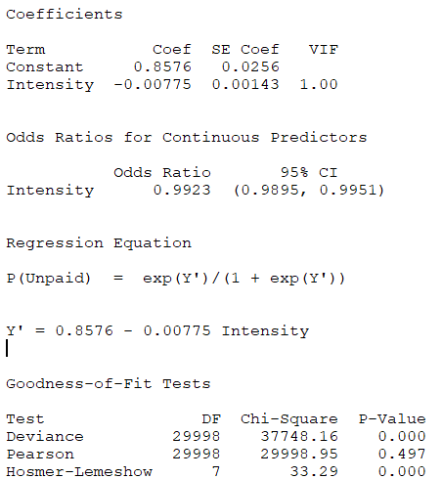
Impact of Calling Intensity on Paid Status
Since P Value is greater than 0.05, i.e. 0.497. Hence Null Hypothesis which means X (Intensity) doesn't have significant impact on Y (Paid Status)

Slide 22
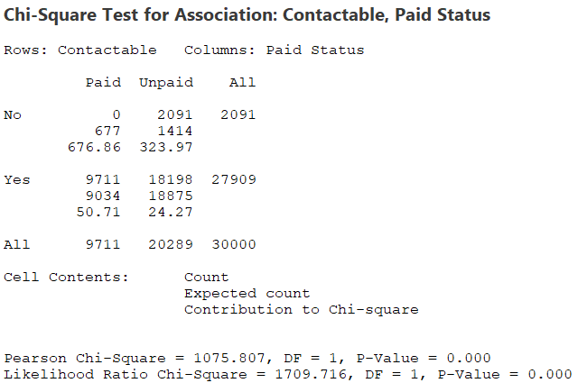
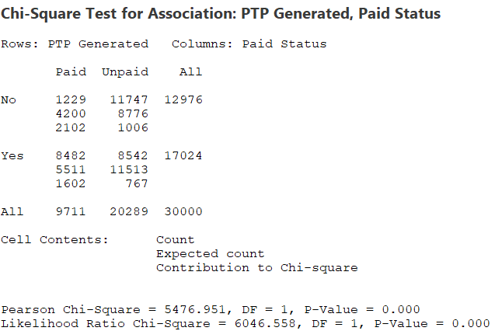
Impact of Contactable and PTP Generated on Paid Status
Since P Value is very than 0.05, Hence Alternate Hypothesis which means X (Contactable & PTP Generated) does have significant impact on Y (Paid Status)
Hence whether Customer is contactable and giving promise is significantly affecting their final paid status.

Slide 23
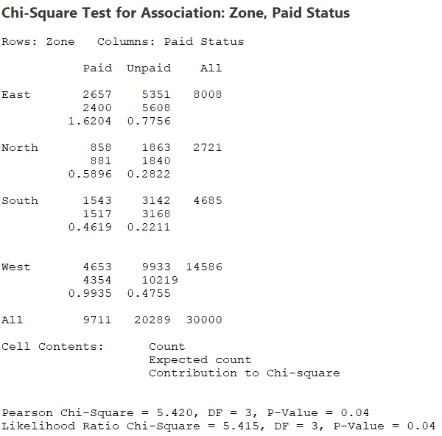
Impact of Zone on Paid Status
Since P Value is less than 0.05. Hence Alternate Hypothesis which means X (Customer’s Zone) does have significant impact on Y (Paid Status)
Proper Calling Strategy need to be build to handle Customer of certain zones to improve Overall Resolution.

Slide 24
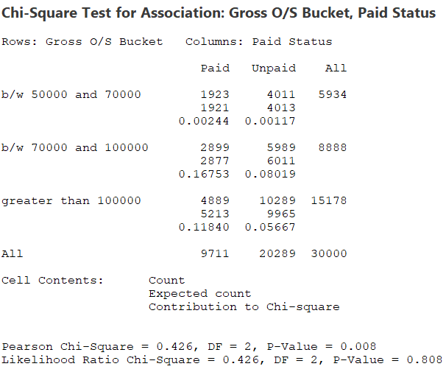
Impact of Gross o/s Bucket on Paid Status
Since P Value is less than 0.05. Hence Alternate Hypothesis which means X (Gross O/S Bucket) does have significant impact on Y (Paid Status)
Proper Band categorization and focus on certain band of customers to draw more impact on customer resolution.

Slide 25
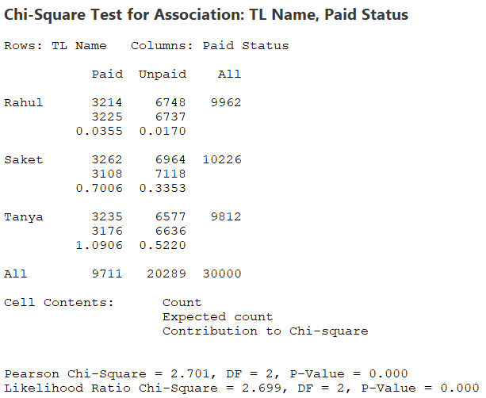
Impact of Team Leaders on Paid Status
Since P Value is less than 0.05. Hence Alternate Hypothesis which means X (Team Leaders) does have significant impact on Y (Paid Status)
Adequate training of Team Leaders are required To maximize the Customer Resolution.

Slide 26
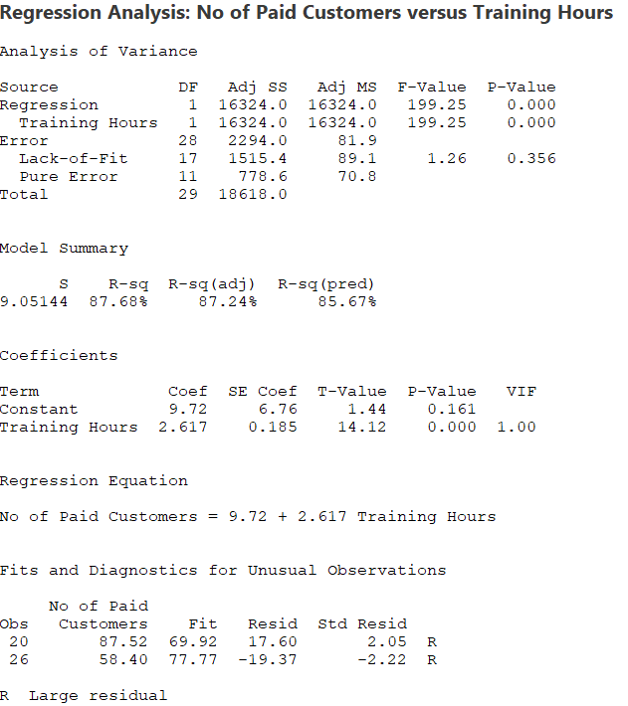
Agent Level Data : Impact of Training hours on No. of Paid Customers
Since Adjusted R-Square value is greater than 60%, we can say Alternate hypothesis, it means X (Training hours) have significant impact on No. of paid customers.
Adequate training of Agents are required To maximize the Customer Resolution.

Slide 27
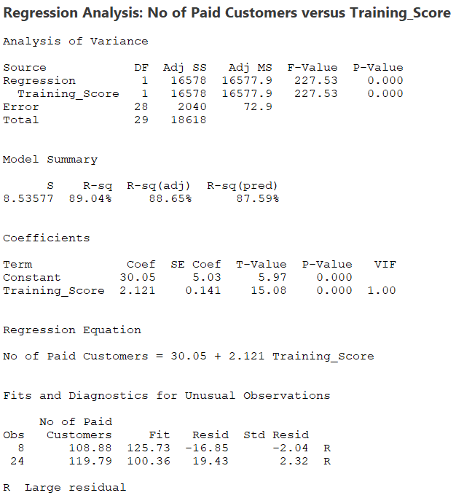
Agent Level Data : Impact of Training Score on No. of Paid Customers
Since Adjusted R-Square value is greater than 60%, we can say Alternate hypothesis, it means X (Training Score) have significant impact on No. of paid customers.
Adequate training of Agents are required To maximize the Customer Resolution.

Slide 28
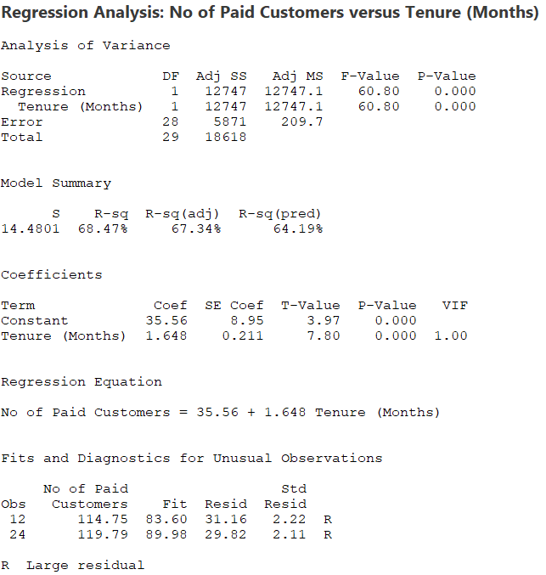
Agent Level Data : Impact of Agent Tenure on No. of Paid Customers
Since Adjusted R-Square value is greater than 60%, we can say Alternate hypothesis, it means X (Agent Tenure) have significant impact on No. of paid customers.
Low tenure agents have less no of customers resolution compared to high tenured or experienced agent.

Slide 29
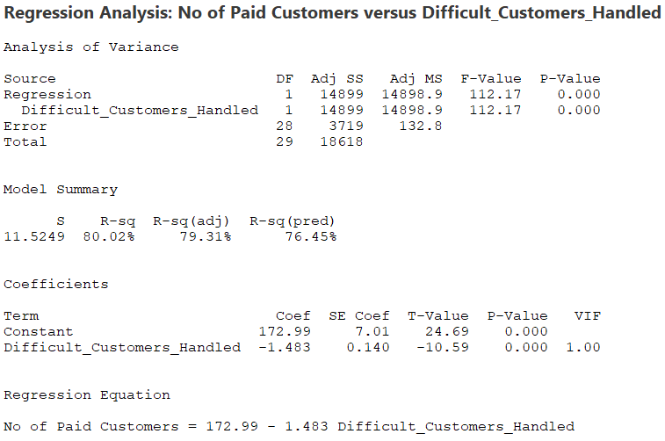
Agent Level Data : Impact of Difficult Customer Handled on No. of Paid Customers
Since Adjusted R-Square value is greater than 60%, we can say Alternate hypothesis, it means X (No. of Difficult Customers Handled) have significant impact on No. of Paid Customers.

Slide 30
Hypothesis Testing Result
No. | Potential Causes (X) | Data type (X vs Y) | Hypothesis test to be used | Related to Root Cause | Result
1 | Bill cycle of customer | Discrete vs Discrete | Chi square Test | Non-availability of analytical solution to build dialling and referral strategy | No Impact
2 | Repeat Category | Discrete vs Discrete | Chi square Test |  | Impact
3 | Intensity | Continoues vs Discrete | Binary Logistic Regression |  | No Impact
4 | Contactable | Discrete vs Discrete | Chi square Test |  | Impact
5 | PTP Generated | Discrete vs Discrete | Chi square Test |  | Impact
6 | Zone | Discrete vs Discrete | Chi square Test |  | Impact
7 | Tenure | Continoues vs Discrete | Binary Logistic Regression |  | No Impact
8 | TL | Discrete vs Discrete | Chi square Test |  | Impact
9 | Training Hours | Continoues vs Continoues | Regression Analysis | Inadequate training for team leaders and agents. | Impact
10 | Training Score | Continoues vs Continoues | Regression Analysis |  | Impact
11 | Gross o/s Category | Discrete vs Discrete | Chi square Test | POS Band categorization is not proper | Impact
12 | Agent Tenure | Continoues vs Continoues | Regression Analysis | New agent is performing relatively low | Impact
13 | Difficult Customer Handled | Continoues vs Continoues | Regression Analysis | Insufficient focus on handling difficult customers. | Impact

Slide 31
Improve

Slide 32
Brainstorming Exercise : Potential Solutions
No. | Confirmed causes | Potential Solution
1 | Non-availability of analytical solution to build dialling strategy | 1. Develop or acquire a robust analytical tool that can analyze past call data and customer behavior to optimize dialing strategies. 2. Engage data scientists or analysts to create predictive models for effective dialing strategies.
2 | Non-availability of analytical solution to build referral strategy | 1. Implement a referral management system that utilizes analytics to identify potential referral opportunities based on customer behavior and satisfaction scores. 2. Train staff on utilizing data-driven referral techniques.
3 | Inadequate training for team leaders and agents. | 1. Establish a comprehensive training program for team leaders and agents that includes customer service skills, and conflict resolution techniques. 2. Implement regular training refreshers and mentorship programs for ongoing support.
4 | POS Band categorization is not proper | 1. Review and update the POS Band categorization criteria based on customer needs and behaviors. 2. Involve cross-functional teams to ensure all perspectives are considered during the categorization process.
5 | New agent is performing relatively low | 1. Implement a structured onboarding program that includes shadowing experienced agents, hands-on training, and gradual increase in responsibility. 2. Provide ongoing performance feedback and coaching tailored to each new agent's needs.
6 | Insufficient focus on handling difficult customers. | 1. Train agents on specific techniques for managing difficult customers, including active listening, empathy, and de-escalation strategies. 2. Implement a feedback mechanism for agents to share challenges and solutions regarding difficult customer interactions.

Slide 33
Solution Selection Matrix
No. | Confirmed causes | Potential Solution | Impact | Cost | Ease | Score
1 | Non-availability of analytical solution to build dialling strategy | 1. Develop or acquire a robust analytical tool that can analyze past call data and customer behaviour to optimize dialling strategies. 2. Engage data scientists or analysts to create predictive models for effective dialling strategies. | 9 8 | 7 7 | 8 7 | 240 220
2 | Non-availability of analytical solution to build referral strategy | 1. Implement a referral management system that utilizes analytics to identify potential referral opportunities based on customer behaviour and satisfaction scores. 2. Train staff on utilizing data-driven referral techniques. | 8 7 | 7 8 | 8 7 | 230 220
3 | Inadequate training for team leaders and agents. | 1. Establish a comprehensive training program for team leaders and agents that includes customer service skills, and conflict resolution techniques. 2. Implement regular training refreshers and mentorship programs for ongoing support. | 9 9 | 7 6 | 6 7 | 220 220
4 | POS Band categorization is not proper | 1. Review and update the POS Band categorization criteria based on customer needs and behaviours. 2. Involve cross-functional teams to ensure all perspectives are considered during the categorization process. | 8 6 | 7 5 | 6 7 | 230 180
5 | New agent is performing relatively low | 1. Implement a structured on boarding program that includes shadowing experienced agents, hands-on training, and gradual increase in responsibility. 2. Provide ongoing performance feedback and coaching tailored to each new agent's needs. | 9 8 | 7 7 | 8 7 | 240 220
6 | Insufficient focus on handling difficult customers. | 1. Train agents on specific techniques for managing difficult customers, including active listening, empathy, and de-escalation strategies. 2. Implement a feedback mechanism for agents to share challenges and solutions regarding difficult customer interactions. | 8 7 | 7 6 | 8 7 | 230 200

Slide 34
Implementing Solutions – 4W1H Technique
What | Where | Who | When | How
Engage data scientists to create predictive dialing models | Call center analytics team | Data Scientists, Analysts | Within the next 2 weeks | Use historical data to build predictive models, run tests on strategies, and optimize the dialing approach based on outcomes.
Train staff on data-driven referral techniques | Online training platform | Training Department | In the next 3 weeks | Organize specialized virtual training sessions focusing on utilizing data for referral techniques and decision-making.
Establish a training program for team leaders and agents | Call center training rooms | HR Department, Trainers | Within the next 4 weeks | Develop short modules on conflict resolution, customer service, and soft skills. Begin scheduling weekly sessions with agents and team leaders.
Implement mentorship and refreshers for agents | On-the-job during regular shifts | Team Leaders, Senior Agents | Immediately | Start pairing agents with experienced team leaders and senior agents for mentoring. Schedule weekly refresher sessions for all agents.
Review and update the POS Band categorization criteria | MIS Team | MIS Analyst | Within 2 weeks | Assess current customer behavior, review POS band criteria, and implement necessary updates based on trends and market insights.
Provide ongoing performance feedback and coaching for new agents | On the floor during shifts | Team Leaders, Supervisors | Ongoing starting next week | Establish a system to provide feedback to new agents after every shift. Regular check-ins with supervisors for performance improvement.
Train agents on handling difficult customers | Online training or in-person training rooms | Trainers, Team Leaders | Within 3 weeks | Conduct targeted training on active listening, empathy, and conflict resolution. Include role-playing to simulate difficult customer scenarios.
Implement a feedback mechanism for agents on handling difficult customers | Feedback portal or meetings | Team Leaders, Customer Service Managers | After training (within 4 weeks) | Set up regular feedback meetings with agents to discuss challenges and successful strategies for handling difficult interactions.

Slide 35
FMEA
Process Step | Potential Failure Mode | Potential Effect of Failure | Sev | Potential Cause of Failure | Prob | Current Control / Design Process | Det | RPN | Recommended Action to Reduce RPN | Ownership | Completion by Date | New Sev | New Prob | New Det | Revised RPN
Develop analytical tool for dialing strategy | Incorrect model predictions | Ineffective dialing strategy, loss of customer engagement | 8 | Poor data quality, lack of validation | 6 | Review by data scientists | 5 | 190 | Validate models with historical data and perform regular updates | Data Science Team | 2 weeks | 6 | 4 | 3 | 130
Build referral management system | Misidentification of referral opportunities | Missed revenue opportunities from referrals | 7 | Inaccurate customer behavior analysis | 5 | Utilize customer feedback for validation | 6 | 180 | Implement regular review and adjust algorithms | Call Center Manager | 3 weeks | 6 | 4 | 4 | 140
Establish training program for agents | Training not effective or insufficient | Poor agent performance and customer dissatisfaction | 8 | Training program lacks practical focus | 7 | Monitor agent performance | 5 | 200 | Add more practical, scenario-based training with assessments | Training Manager | 4 weeks | 7 | 4 | 3 | 140
Review POS Band categorization | Incorrect customer categorization | Customer misalignment, impact on customer service | 9 | Outdated categorization process | 6 | Use behavior analytics | 4 | 190 | Involve cross-functional teams for periodic review | Ops Lead | 2 weeks | 7 | 3 | 3 | 130
Implement structured onboarding for new agents | Slow skill development | New agents underperform, customer service issues | 8 | Onboarding process not thorough | 7 | Shadowing experienced agents | 5 | 200 | Add weekly performance feedback and mentorship | HR & Ops | 5 weeks | 6 | 4 | 4 | 140
Train agents on handling difficult customers | Agents unable to handle complex issues | High customer churn, poor experience | 9 | Lack of conflict resolution training | 6 | Role-playing exercises and customer feedback | 5 | 200 | Enhance training with real case studies, role-play advanced scenarios | Training Manager | 4 weeks | 7 | 4 | 3 | 140

Slide 36
Control

Slide 37
Control Chart
After applying Six Sigma methodology to the identified causes, we observed a week-to-week increase in customer resolution during the control phase.
The P control chart indicates that the process is stable, as all data points fall within the control limits.
*The time interval for the chart is weekly, and the weekly volume is assumed to be constant due to insufficient data for a monthly plot.

Slide 38
Process Capability in Control phase
No. of Units (Total Allocations) | No. of Defects (Unpaid Customer) | Defects Opportunities Per Unit | Defect Per Unit (DPU) | Defect Per Opportunity (DPO) | Defect Per Million Opportunity (DPMO) | Sigma Level
10000 | 6377 | 1 | 0.63 | 1 | 637700 | 2.9
After applying the Six Sigma methodology to the identified causes, we observed a reduction in both DPU and DPMO levels.
Overall, the sigma level of the process increased from 2.6 to 2.9, indicating significant process improvement.
Process Sigma = Normsinv(1+D/O)+1.5))
D – Total Defects
O- Total Opportunities
* Total allocations here calculated based on the data from Aug’24 to Sep’24 taking monthly allocation volume 5000.

Slide 39
Voice of Business and Customer
Business/Customer | VOB/VOC | CTQ
Operation Head | Improve customer resolution percentage over the months to reduce penalties and retain business. | Higher customer resolution rate.
Manager - Operations | New agents are now performing well and able to handle difficult customers. | Better performance by new agents.
Quality Assurance Team | Ensure consistency and accuracy in customer list data and correct discrepancies. | Reduction in data discrepancies.

Slide 40
Thank you.

